Slide 1
Course Name
Climate Change Adaptation and Mitigation (NaRM3121)
College of Agriculture Natural Resource Sciences
Department of Natural Resource Management
Instructor:- Yitea Seneshaw (PhD)
Dec, 14, 2020

Slide 2
Is climate change true , how do we know? What are the evidences
Chapter 1. Introduction (8 hours)
1.1. Climate change and variability (definition)
1.2. Past, present and future predictions of climate change
1.3. Evidences of climate change
1.4. Why climate change is a global issue?
1.5. Climate change and society
2. Drivers of climate change
  Natural causes
  Anthropogenic drivers
    Technological development and transportation
    Increased world industrial activities
    Material and energy consumption growth
    Land use change and deforestation
Chapter 3. Vulnerability to and Impacts of climate change
3.1. Vulnerability
3.2. observed and projected impacts on natural ecosystem
3.3. Impacts of climate change on agricultural system
3.4. Impacts of climate change on human health
3.5. Climate change impacts on sustainable development
Chapter 4. Adaptive capacity and adaptation to climate change
4.1. Adaptive capacity
4.2. Adaptation
Chapter 5. Climate change mitigation strategies
5.1. Carbon sequestration
5.2. Reduced emission
5.3.Carbon trading
Chapter 6. Global policies, Conventions and protocols on climate change
6.1. Adaptation policy
6.2. Montreal
6.3. United Nations Framework Convention on Climate Change
6.4. Kyoto protocol
6.5. Issues of concern: sharing responsibility, policy response, carbon trade
Chapter 7. An overview of climate change adaptation strategy of Ethiopia
What are drivers of climate change
Climate change
Vulnerability and Climate
change
impacts
Greenhouse
gas emissions
Mitigation:
Carbon sinks: forests and land use Changes (CO2 sequestration)
Mitigation:
Reduce emissions,
Reduce magnitude
of CC (e.g. less
CO2)
Adaptation
Reduce vulnerability
to CC impacts;
Reduce losses
Global policies, Conventions and protocols on climate change

Slide 3
Chapter 1. Introduction
  1.1 Climate change and variability (definition)
Climate is “the long term average" weather for a given place or region.
For example, on average, Ethiopia is expected to be sunny in December, rainy in July and cold in January but there may be annual deviations.
In other words, climate is statistical description in terms of the mean , a synthesis of weather variation focusing on a specific area for a specified interval.
Climate is usually based on the weather in one locality averaged for at least 30 years.
Climate change refers to any change in climate over time, whether due to natural variability or anthropogenic forces.
Climate change is attributed to both natural variability and human activities.
For so long, variation in climate parameters is generally attributed to natural causes. However, because of changes in the earth’s climate since the pre-industrial era, some of these changes are now considered attributable to human activities.

Slide 4
Chapter 1. Introduction
  1.1 Climate change and variability (definition)
Climate variability refers to variations in the mean state and other climate statistics (standard deviations, the occurrence of extremes, etc.) on spatial–temporal scales . Variability may result from natural or anthropogenic forcing and some years have below average rainfall, others have average or above average rainfall. For example, the average annual rainfall of Debre Berhan city is 986 mm. The actual rainfall varying from the mean represents drought and flood conditions. The best example is ENSO, El Niño
If climate variability is year to year or month to month variation occurs over months
to decades. Climate change is a long-term continuous change (increase or decrease) to average weather conditions (e.g. average temperature, rainfall ). Both can also happen simultaneously. Long-term means at least many decades. Climate change is slow and gradual, and unlike year-to-year or month to month like climate variability.

Slide 5
Chapter 1. Introduction
  1.1 Climate change and variability (definition)
Weather is the actual state of the atmosphere in a period of several hours up to a few days (in a given place). “State of the atmosphere with respect to heat or cold, wetness or dryness, calm or storm, clearness or cloudiness. Also, weather is the meteorological day-to-day variations of the atmosphere and their effects on life and human activity.
“Climate is what we expect, weather is what we get.”
– Mark Twain

Slide 6
Chapter 1. Introduction
  1.2 Past, present and future predictions of climate change
  1.2.1 Past climate (climate change)
Paleoclimatology is the study of climates for which direct measurements were not taken. As instrumental records only a short period of time, the reconstruction of ancient climate is important to understand natural variation and the evolution of the current climate. Paleoclimatology uses a variety of proxy methods from the Earth and life sciences to obtain data previously preserved within rocks, sediments, ice sheets, tree rings, corals, shells, and microfossils to determine the past states of Earth's atmosphere combined with the current techniques.
Paleoclimatology came to maturity in the 20th Century due to the frequent glaciations, rapid cooling events such as the Younger Dryas, and the fast rate of warming during the Paleocene– Eocene Thermal Maximum. Studies of past changes in the environment and biodiversity often reflect on the current situation, specifically the impact of climate on mass extinctions and current global warming.

Slide 7
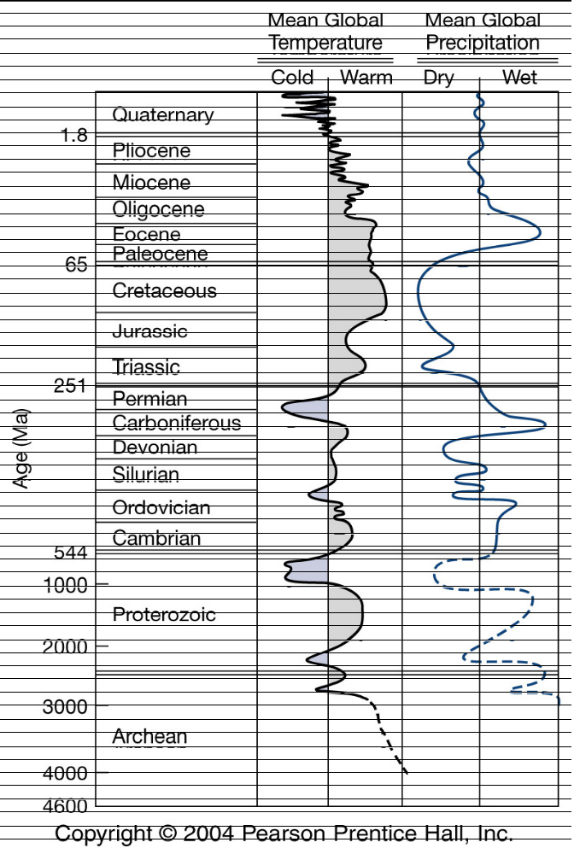
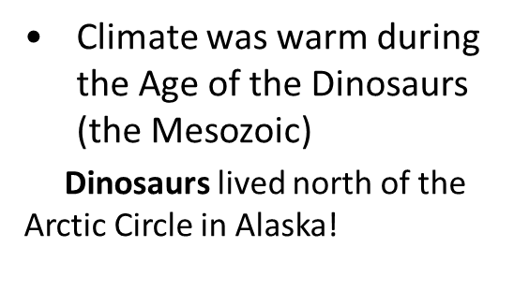
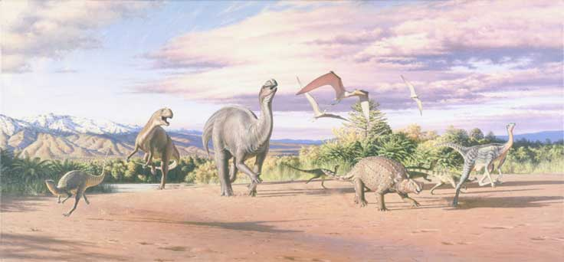
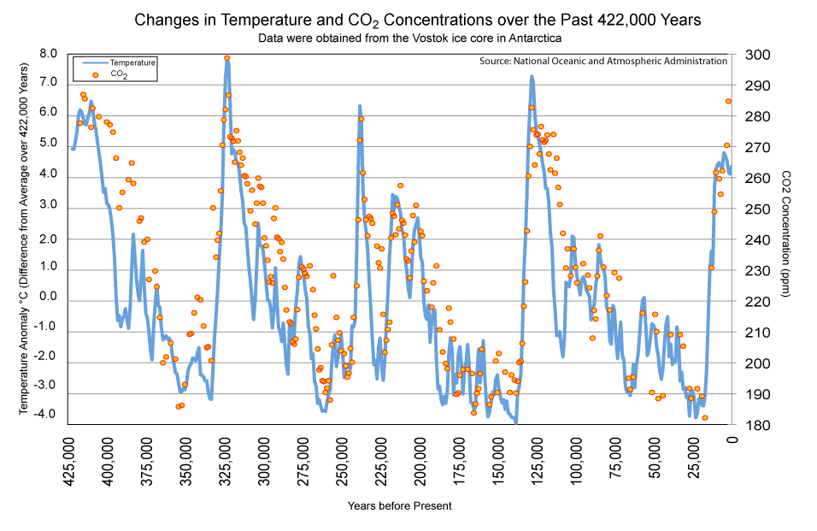
Chapter 1. Introduction
  1.2 Past, present and future predictions of climate change
  1.2.1 Past climate (climate change)
Present day
Cenozoic
Mesozoic
interglacial periods
Paleozoic
Snowball earth
Glacial periods
PreCambrian
Earth birth

Slide 8

Chapter 1. Introduction
  1.2 Past, present and future predictions of climate change
  1.2.1 Past climate (climate change)
Glacials and interglacials had occurred in fairly in regular repeated cycles. The timing is governed to a large degree by predictable cyclic changes in Earth’s orbit, which affect the amount of sunlight reaching different parts of Earth’s surface.
A, The three orbital variations are:
changes in Earth’s orbit around the Sun (eccentricity),
shifts in the tilt of Earth’s axis (obliquity), and
the wobbling motion of Earth’s axis (precession).
Eccentricity changes on
a ~100,000 year cycle
changes in the shape of the Earth's orbit as the Earth rotates about the Sun. The more eccentric the orbit the more elliptical the orbital shape. There is a good correlation, between periods of low eccentricity and glacial periods
The axis tilt is 23.5°, but the axis varies from ~22° to 24.5° once every 41,000 year. The smaller the tilt, the less seasonal variation. For small tilt, the winters would tend to be milder and the summers cooler. This would lead to more glaciation.
precession = wobbliness of Earth from gravitational pull of other planets - occurs every 23,000 years Northern Hemisphere

Slide 9
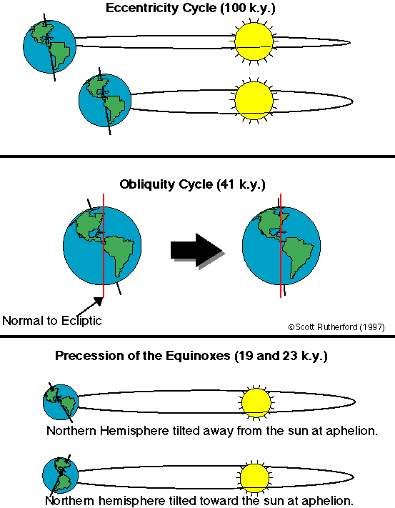
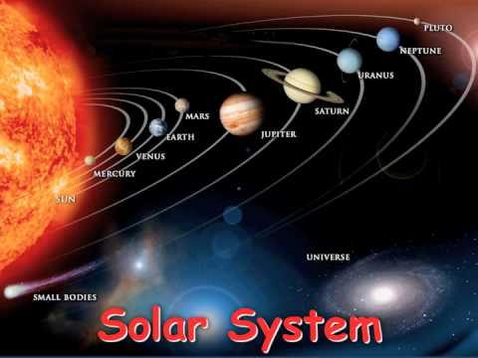
Chapter 1. Introduction
  1.2 Past, present and future predictions of climate change

Slide 10
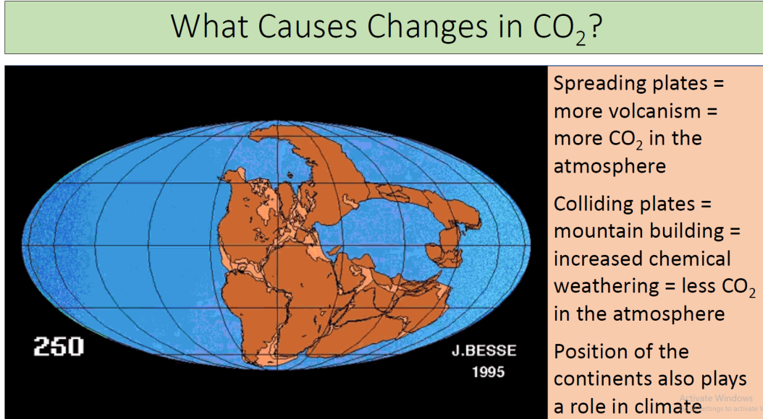
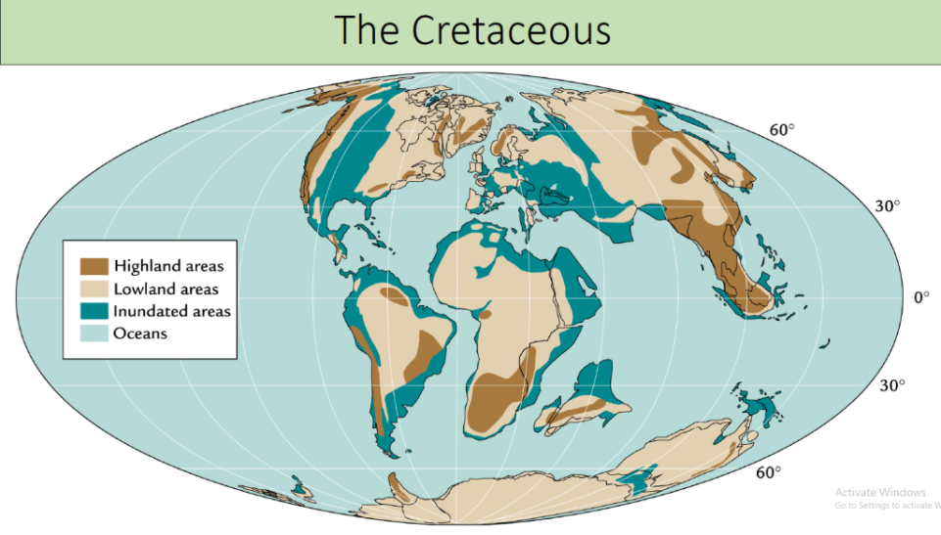
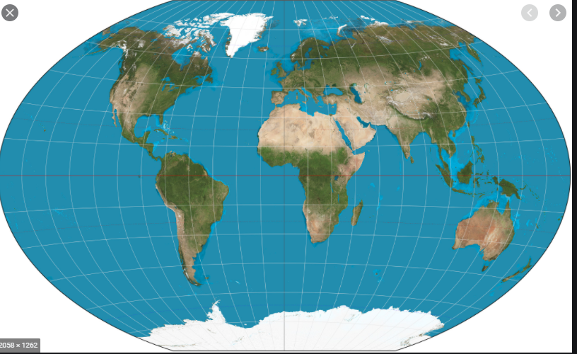
Chapter 1. Introduction
  1.2 Past, present and future predictions of climate change
  1.2.1 Past climate (climate change)
B, Plate tectonics
It is also important to recognize that CO2, CH4, and NO2 show high concentration during interglacial times and lower concentrations during the glacial episode.

Slide 11
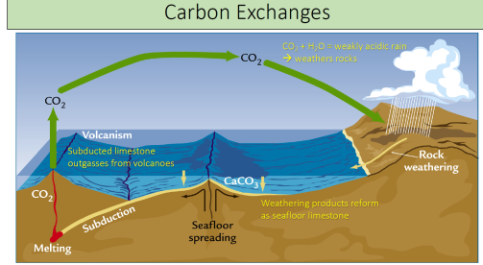
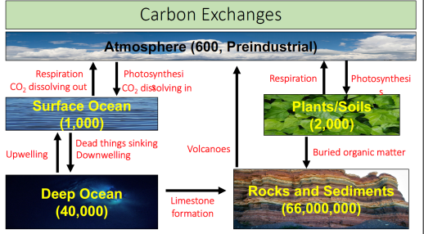
Chapter 1. Introduction
  1.2 Past, present and future predictions of climate change
  1.2.1 Past climate (climate change)
B, Plate tectonics
What explains the warming? Atmospheric CO2 decrease due to
• increase of Volcanism
• decrease of chemical weathering
respiration
What explains the cooling? Atmospheric CO2 decrease due to
• Reduced Volcanism
• Increased chemical weathering
Photosynthesis
Unit of carbon Petagrams

Slide 12
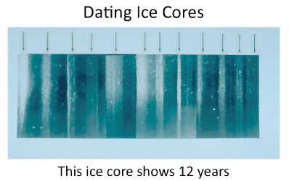
Chapter 1. Introduction
  1.2 Past, present and future predictions of climate change
  1.2.1 Past climate (climate change)
Methods to establish past climate
Isotopic Geochemical Studies: the study of rock isotopic ratios, ice core bubbles, etc.
Dendroclimatology: the study of tree rings
1. Ice core method
Based on ice core, the summer band of ice appear to be white because of the snow experiences sunlight for 24 hrs and ice appear s to be dark in the winter .
Air trapped within fallen snow becomes encased in tiny bubbles as the snow is compressed into ice in the glacier under the weight of later years' snow. The trapped air has proven a tremendously valuable source for direct measurement of the composition of air from the time the ice was formed.

Slide 13
Chapter 1. Introduction
  1.2 Past, present and future predictions of climate change
  1.2.1 Past climate (climate change)
1. Ice core method
Layering can be observed because of seasonal pauses in ice accumulation and can be used to establish chronology, associating specific depths of the core with ranges of time.
Changes in the layering thickness can be used to determine changes in precipitation or temperature.
Oxygen-18 quantity changes in ice layers represent changes in average temperature. Water molecules containing the heavier 18O evaporate at a higher temperature than water molecules containing the normal Oxygen-16 isotope.
Pollen has been observed in the ice cores and can be used to understand which plants were present as the layer formed. Knowing which plants were present leads to an understanding of precipitation and temperature, and types of fauna present.

Slide 14
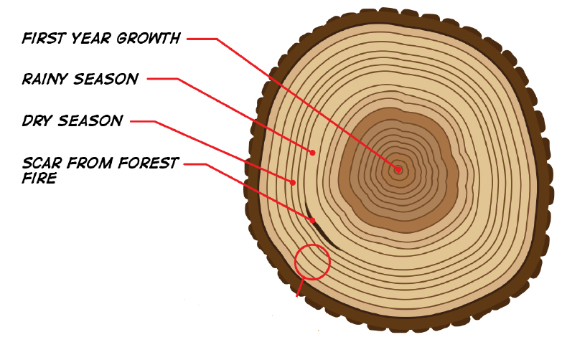
Chapter 1. Introduction
  1.2 Past, present and future predictions of climate change
  1.2.1 Past climate (climate change)
2. Tree-ring method
Generally, trees respond to changes in climatic variables by speeding up or slowing down growth, which in turn is generally reflected by a greater or lesser thickness in growth rings. Different species, however, respond to changes in climatic variables in different ways.
Trees add rings every year
• Ring width reflects tree age
and environmental conditions
With the help of instrumental record of temperature for the last 80 years, regression correlation analysis of tree ring widths with measured temperature for that same set of years can be conducted and extrapolated for the remaining years.
During photosynthesis, carbon dioxide stored in the part of the tree from the atmosphere. The result is sugar that a tree uses to build its rings. Therefore, the carbon that was taken into a tree at a particular time becomes captured in the cells of the tree. This can give us information about the atmospheric gases at the time that a particular tree ring formed. Carbon 12 and 13 isotopes. Most of the carbon in our atmosphere is ¹²C.

Slide 15
Chapter 1. Introduction
  1.2 Past, present and future predictions of climate change
  1.2.2 Present climate (climate change)
Thanks to technology, we now have long-term monitoring programs via advanced remote satellite and radar data with ground-truth measurements , which aim to measure the current state of our oceans, land and atmosphere.
Historic and instrumental records of climatic change demonstrate that global average temperatures have risen by 0.72 ºC since the 1950’s ( industrial revolution) due to the increase of CO2 or (GHGs) concentration in the atmosphere as a result of burning fossil fuels, deforestation etc.
Global warming, resulting from climate change, has emerged as the most serious
environmental threat, suggesting that the mankind is heading for deep trouble
unless a drastic cut is made in emission of greenhouse gases into the atmosphere. . An increasing rate of warming has taken place over the 3 last 25 years, and 11 of the 12 warmest years on record have occurred in the past 12 years.

Slide 16
Chapter 1. Introduction
  1.2 Past, present and future predictions of climate change
  1.2.2 Present climate (climate change)
Beneath the increasing trends of temperature , current climate shows significant variability, on timescales of years to decades, which are of importance to agriculture and forestry. Those that are most important interannually are the El Niño/Southern Oscillation (ENSO) and the North Atlantic Oscillation (NAO).
There is nothing inherently wrong with climate change. It has happened in the past and will happen again. The current concern stems from the rate of change – how quickly changes are happening.
Scientists have found that the current rate of temperature increase is higher than any previously seen in the last 800,000 years. Evidence strongly indicates that human-driven changes in the atmosphere are contributing to the unprecedented rate of temperature increase.

Slide 17
Chapter 1. Introduction
  1.2 Past, present and future predictions of climate change
  1.2.2 Present climate (climate change)
Warming in the 21st century greatest over land with the following impacts
Increases in the amount of rainfall are very likely in high latitudes, while decreases are likely in most subtropical land regions.
Drought-affected areas will likely increase in extent.
It is very likely that hot extremes, heat waves and heavy rainfall events will continue to become more frequent.
Water resources are inseparably linked with agriculture. Annual average river runoff and water availability are projected to increase by 10-40% at high latitudes, and decrease by 10-30%over some dry regions at mid-latitudes and in the dry tropics.
Increases in drought and flood frequency are projected to affect local crop production negatively, especially in subsistence sectors at low latitudes.
There have been increased insect outbreaks impacting agriculture, forestry and ecosystems.

Slide 18
Chapter 1. Introduction
  1.2 Past, present and future predictions of climate change
  1.2.3 Future predictions of climate
After individuals struggle and different workshops, IPCC (Intergovernmental Panel on Climate Change) was established in 1988.
IPCC describe how the future holds with respect to the variety of factors (socio-economic change, technological change, emissions of GHGs).
Special Report on Emissions Scenarios (SRES)
Representative Concentration Pathways (RCP)
GHG Emissions | Scenarios |  | Tem (°C) increase by 2081-2100 relative to 1850-1900 |  | Mean Tem rise and C0₂
 | RCP | SRES | SRES | RCP
High | 8.5 | A2 | 2.0-5.4 | 3.2-5.4 | 4.3 (936ppm)
M-H | 6.0 | A1 | 1.4-6.4 | 2.0-3.7 | 2.8 (670ppm)
M | 4.5 | B2 | 1.4-3.8 | 1.7-3.2 | 2.4 (538ppm)
Low | 2.6 | B1 | 1.1-2.9 | 0.9-2.3 | 1.6 (421ppm)

Slide 19
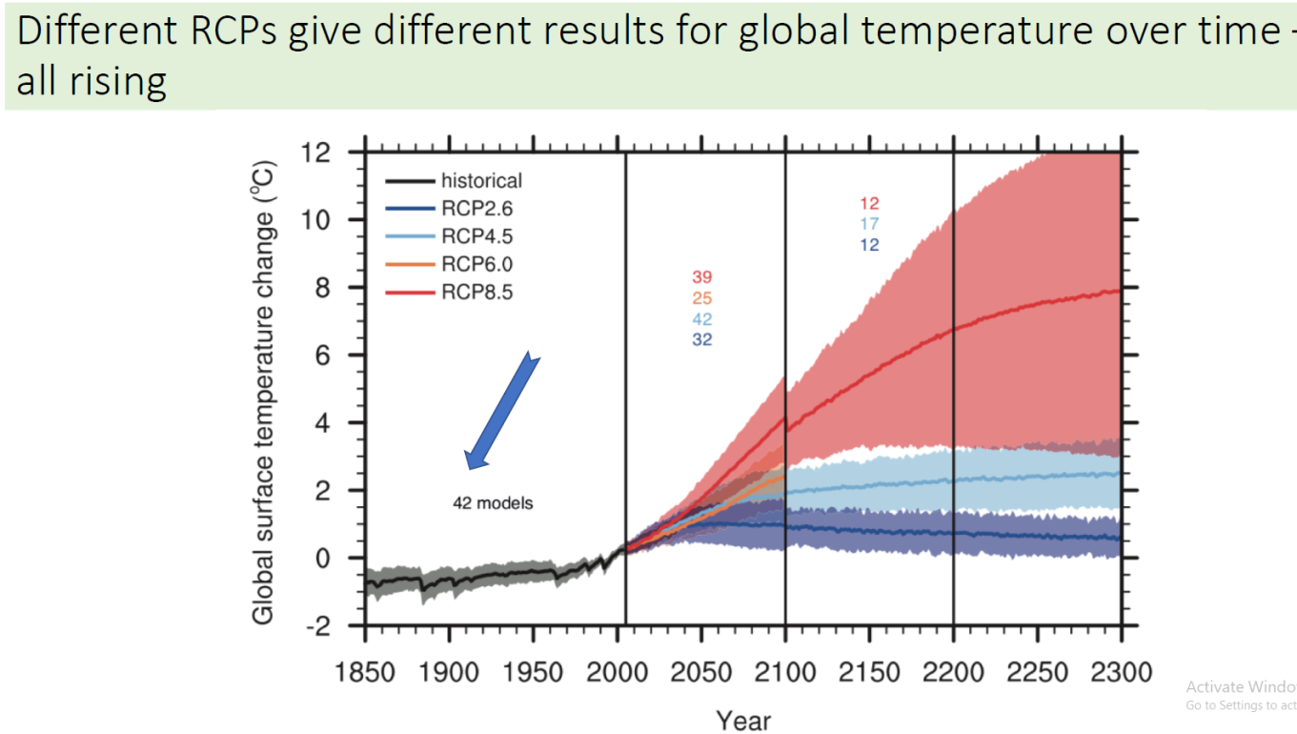
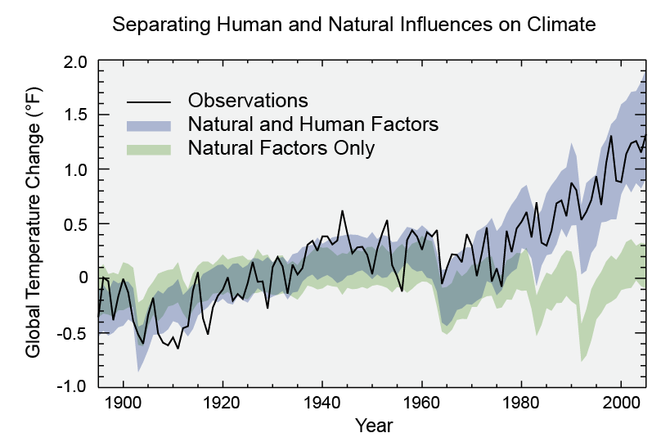
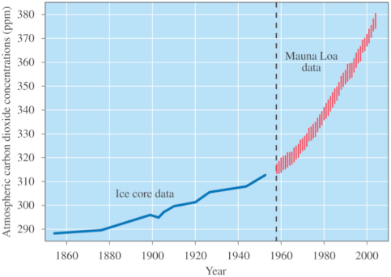
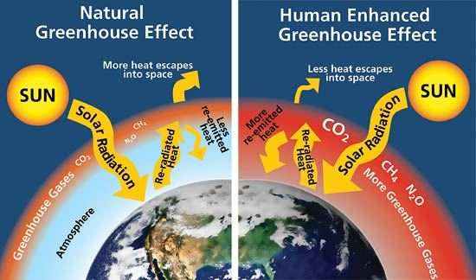
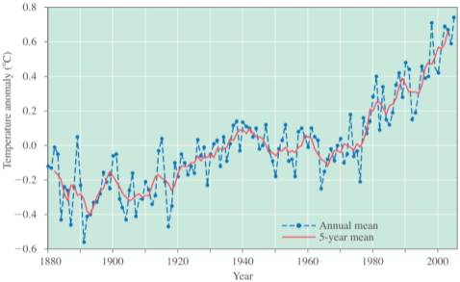
Chapter 1. Introduction
  1.2 Past, present and future predictions of climate change
  1.2.3 Future predictions of climate
We can also assess future impacts by using highly sophisticated computer simulations.
Climate Variability
Climate Change

Slide 20
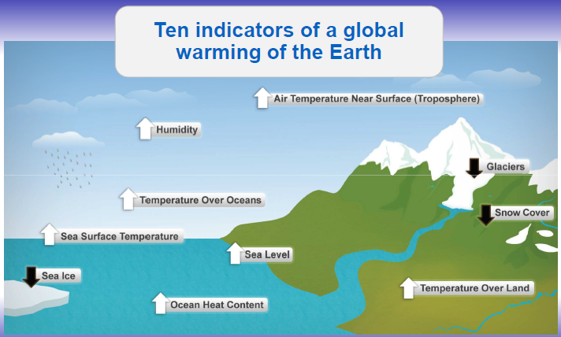
Chapter 1. Introduction
  1.3 Evidences of climate change
Climate change is a real and urgent challenge that is already affecting people worldwide.
Significant changes are occurring on Earth, including increasing air and ocean temperatures, increases in extreme weather events, widespread melting of snow and ice, and rising sea levels, increased activity and abundance of disease vectors etc.
Global warming
Global warming is the phenomenon of rising average air temperatures near Earth's surface over the past 100 to 200 years and already causing damage around the globe. Since industrial era there is a continues increment on global temperature, resulting in reduced crop yields in seasonally dry and tropical regions.

Slide 21
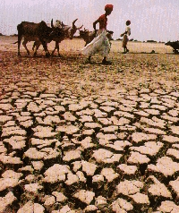
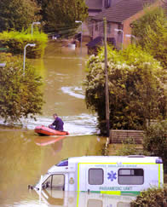
Chapter 1. Introduction
  1.3 Evidences of climate change
Increase of extreme climate event
Increased frequency and severity of extreme climate events, such as heat stress, droughts , & flooding, have been detected for the last few decades due to climate change. It will increase negative impacts on agriculture, & forestry in all regions.
On a global scale, warming strengthens the hydrologic cycle, mainly because warmer air can hold more water vapor. Increased atmospheric water vapor loading can also amplify extreme precipitation. Warming leads to more evapotranspiration
Drought is an intricate natural catastrophe, which starts with a prolonged deficit of rainfall (commonly a season or more in length) and then propagates to soil moisture deficit depending on its duration and severity that leads to a deficit of streamflow and water shortage, which results in severe economic and environmental problems.
Flood is inundation of land due to river overflow, which is caused by heavy rain or torrents of water from other areas in higher places.

Slide 22
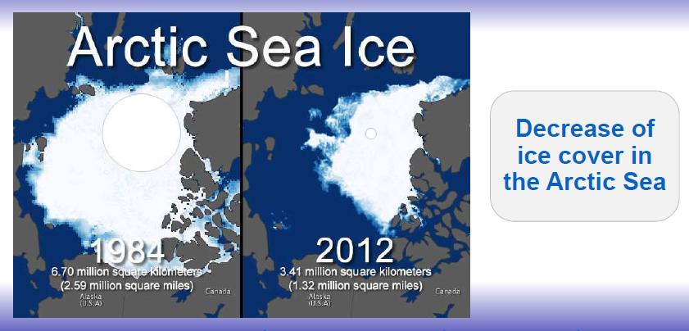
Chapter 1. Introduction
  1.3 Evidences of climate change
Shrinking ice cover and loss of glaciers
Mountain snowpack constitutes a critical reservoir of fresh water. In almost every mountainous region across the world, glaciers are disappearing in response to the warming climate. The shrinkage of glaciers is already creating water shortages. In Africa, 82 percent of the ice on Mt. Kilimanjaro has disappeared since 1912, with about one-third melting in just the last dozen years. The ice over that is there year round is shrinking at a rate of 9% every 10 years; at the rate it is going, it could be gone by the year 2100 or sooner if melting accelerates as some scientists believe is happening.
Increased temperatures has led to changes in rainfall patterns, decreasing the amount of rainfall in some areas and increasing it in others.

Slide 23
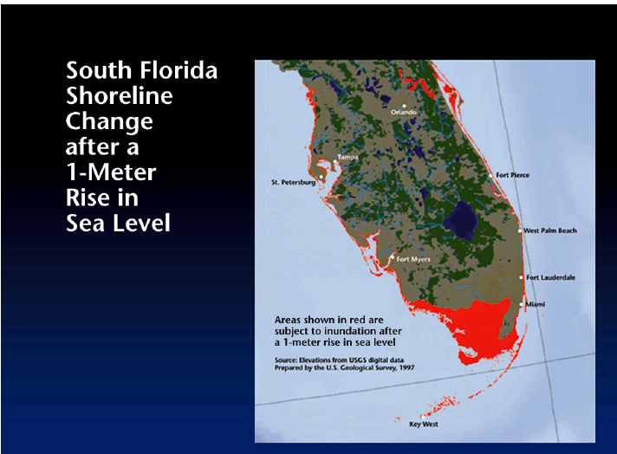
Chapter 1. Introduction
  1.3 Evidences of climate change
Rising sea level
During the 20th century, sea levels around the world raised by an average of 4 to 8 inches (10 to 20 cm), ten times the average rate over the last 3,000 years. This rise in sea levels is caused by thermal expansion of the oceans and by the addition of water to the oceans as a result of the melting and discharge of ice from mountain glaciers and ice caps and from the much larger Greenland and Antarctic ice sheets. Rising sea levels could damage coastal regions through flooding and erosion.
A significant fraction of the world population is settled along coastlines, often in large cities with extensive infrastructure, making sea-level raise potentially one of the most severe long-term impacts of climate change, depending upon the rate and ultimate magnitude of the rise.

Slide 24
Chapter 1. Introduction
  1.3 Evidences of climate change
Ocean Acidification
The oceans play a major role as one of the Earth´s large CO₂ sinks. Acidification of the world’s oceans because of increasing atmospheric CO₂ concentration is, thus, one of the most tangible consequences of CO₂emissions and rising CO₂ concentration.
Disease outbreaks
Climate change could also affect health and well-being of human. Many larger cities could experience a significant rise in the number of very hot days. Air pollution problems would increase causing respiratory problems at greatest risk of health effects ( as Tem rise asthma increase maturation of disease-causing agents and the organisms that transmit them, especially mosquitoes and rodents.
Increased Famine and food insecurity
Food supply is likely to be disrupted by more frequent and severe climate extremes. Utilization of food may be affected negatively by increases in crop, livestock and human pests and diseases, as well as by reduced water availability and water quality, of importance for food preparation.

Slide 25
1.4 Why climate change is a global issue?
Chapter 1. Introduction
Nearly everything is affected by weather and climate and many of our activities themselves affect the climate, through the release of greenhouse gasses (GHG). The GHG release in one place affects the whole world. Climate change is widely recognised as a serious potential threat to the world’s environment. Climate change is an inevitable and urgent global challenge with long-term implications for the sustainable development of all countries. climate change is a global issue mainly due to the sheer scale of climate change impacts both in terms of its global and temporal spread and of the variety of sectors affected by it.
One aspect of globalization that would find much greater interest and attention from leaders of public opinion and from various walks of life are the global economic and equity dimensions of climate change. The causes of human-induced climate change are now well established, and are explained by IPCC. It is true that Warming of the climate system is unequivocal.
Climate change impacts :
  Large share of economy in climate sensitive sectors (e.g. agriculture, tourism)
  Prone to natural disasters (e.g. floods and droughts)
  Adds to existing water resource stresses
  Exacerbated human health, ecosystems, food security, clean water and other resource access concerns

Slide 26
Chapter 1. Introduction
1.5 Climate change and society
Society evolved through formation of groups from family to occupation based to interest based groups, etc. Climate change is expected to have an impact on a wide range of socio-economic areas including human health. Through time, human interface with natural environment changes & human beings acquire different information & knowledge.
Weather and climatic condition of an area exerts impact on available natural resources and these natural resources provides opportunities and hurdles for human being for designing their livelihood practices leading to formation of social groups & their cultural practices. The interface of W & C with human life is not so simple, rather it is a complex interaction linking many aspects of physical & social environment through evolution of cultural landscape on a natural landscape. The influence of weather and climate on human society and culture streamline through human life style, evolved around their occupation, food system, housing or shelter, technology & material uses etc.

Slide 27
Chapter 1. Introduction
1.5 Climate change and society
Society in harsh weather and climate area are highly dependent on more material and energy that in turn affect the climate system , while the opposite is true.
In today’s world, increase of human population and proliferation of material intensive socio-cultural practices lead to problems like climate change.
Therefore, IPCC’s analysis explains that global Green House Gases(GHG) emission grew up due to human activities since pre-industrial times, it has seen an increase of 70% between1970 and 2004.
Atmospheric concentrations of CO₂, methane (CH4) and nitrous oxide (N2O) have increased markedly as a result of human activities since 1750 .
Human influences are there with increase of temperature, changes in wind patterns, heat wave, drought, sea level rises.
These may link to further destabilization of society through climate induced migration, food crisis, disaster etc.

Slide 28
Chapter 2. Drivers of climate change
1. Natural drivers of climate change
Natural causes include Variations in the Earth’s orbit, Plate tectonics, Solar Variations , the circulation of the ocean and the atmosphere, and volcanic activity.
Volcanic eruptions
Volcanism has long been implicated as a possible cause of weather and climate variations. Large-scale volcanic activity may last only a few days, but the massive outpouring of gases and ash can influence climate patterns for years. Sulfuric gases convert to sulfate aerosols, droplets containing about 75% sulfuric acid. These aerosol particles can linger as long as 3-4 years in the stratosphere. Major eruptions alter the Earth's radiative balance because volcanic aerosol clouds absorb terrestrial radiation, and scatter a significant amount of the incoming solar radiation, an effect known as "radiative forcing" that can last from two to three years following a volcanic eruption. "Volcanic eruptions cause short-term climate changes and contribute to natural climate variability“.

Slide 29
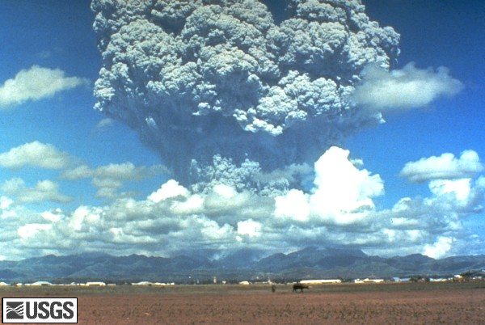
Chapter 2. Drivers of climate change
1. Natural drivers of climate change
Volcanic eruptions
COOLING - Increased volcanism can create enough dust and soot to block out sunlight and reduce global temperatures in the short term (several weeks). Further more, for several years volcanic sulphuric acid aerosol clouds can help reduce temperature through ‘radiation forcing’ by scattering the sun’s radiation. The eruption of Mt Pinatubo in 1991 (20 million tons of sulphur dioxide and ash particles blasted more than 20km high into the atmosphere) is believed to have reduced global temperature by 0.2- 0.5⁰C
WARMING - In the very distant past, there have been volcanic eruptions so massive that they covered vast areas in lava more than a kilometre thick and appear to have released enough CO2 to warm the planet after the initial cooling caused by the dust. But even with such gigantic eruptions, most of subsequent warming may have been due to methane released when lava heated coal deposits, rather than from CO2 from the volcanoes.
Pinatubo June 15, 1991, Philippines

Slide 30
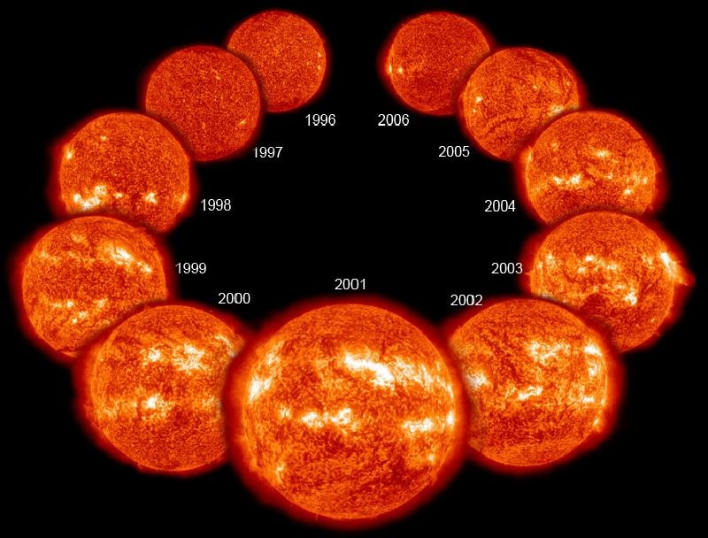
Chapter 2. Drivers of climate change
1. Natural drivers of climate change
Solar Variations
The sun is obviously the largest external source of energy for the earth. Our planet wouldn't be inhabitable without warmth from the sun! But, did you know that the energy output from the sun isn't constant? The sun is a "variable star," which means that its brightness changes in time. When the sun emits more energy, the earth warms up a bit. When the sun emits less energy, the earth cools a bit.
Sunspots (dark areas) and bright spots (called faculae)
Variations in sunspots help scientists track an 11-year solar cycle, during which the sun's energy output varies.

Slide 31
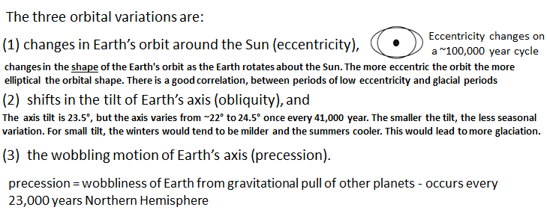
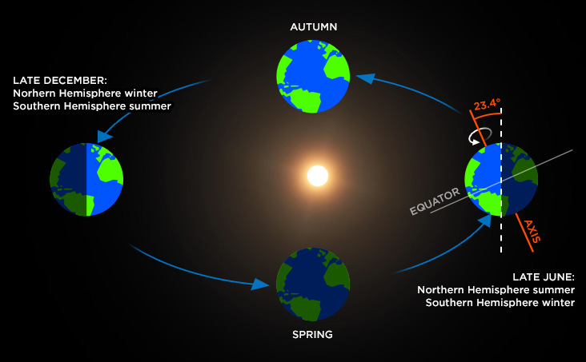
Chapter 2. Drivers of climate change
1. Natural drivers of climate change
Orbital Variability
Earth spins around its axis called Earth's rotation causes day and night , one rotation =24hrs. At the same time that the Earth spins on its axis, it also orbits, or revolves around the Sun called revolution, causes seasons (summer, winter, etc.), one revolution =365 days= 1yr

Slide 32
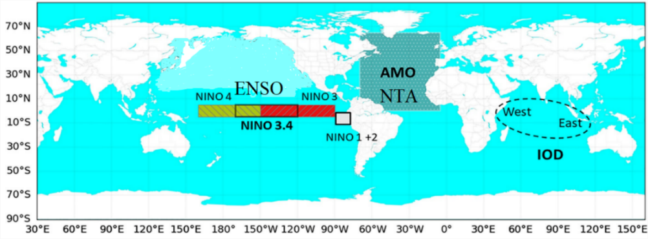
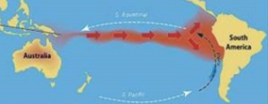
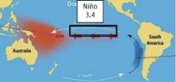
Chapter 2. Drivers of climate change
1. Natural drivers of climate change
Circulation of the ocean and the atmosphere
Large ocean currents speed up and slow down over time, and various portions of the oceans have their own warming and cooling cycles. Because the oceans exchange moisture and energy with the atmosphere, these ocean cycles can affect the atmosphere, too. Natural climate variability namely, El Niño-Southern Oscillation (ENSO) from tropical pacific Ocean, has two episodes the cooling and warming in the central/eastern equatorial Pacific Ocean, which is La Niña and El Niño, respectively.
These cyclic processes of ENSO that involves Ocean surface temperature fluctuation between western and eastern equatorial Pacific along variations in the atmospheric circulation have become a leading source of inter-annual climate variability worldwide, which causes drought in one place and flood in another.
El Niño
Normal

Slide 33
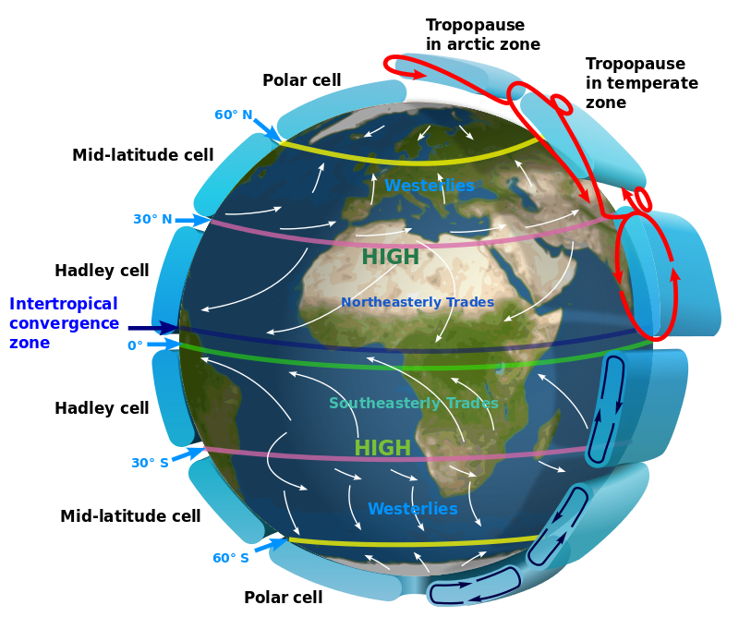
El Niño-Southern Oscillation (ENSO)

Slide 34
Chapter 2. Drivers of climate change
2. Anthropogenic drivers of climate change
Enhanced greenhouse effect is considered the result of human activities that have increased atmospheric concentrations of greenhouse gases and aerosols since the pre-industrial era (since about 1750). The atmospheric concentrations of key greenhouse gases include carbon dioxide (CO2), methane (CH4), nitrous oxide (N2O) and ozone (O3). Besides to the halocarbons (a group of gases containing fluorine, chlorine and bromine) GHGs. They reached their highest recorded levels in the 1990s, primarily due to the combustion of fossil fuels, agriculture, and land-use changes. Human causes of climate change includes, technological development, industrialization, growth of energy consumption, burning fossil fuels, cutting down forests, and developing land for farms, cities, and roads. These activities all release greenhouse gases into the atmosphere that trap outgoing long wave radiation and increase the global temperature (global warming). The consumption of fossil fuels (energy production, fuel for vehicles, home heating, and industry) is by far the most incriminating factor.

Slide 35
Chapter 2. Drivers of climate change
2. Anthropogenic drivers of climate change
Some amount of greenhouse gases is necessary for life to exist on Earth—they trap heat in the atmosphere, keeping the planet warm and in a state of equilibrium. But excess of GHGs in the atmosphere as human activities (such as the combustion of fossil fuels), resulting in a shift in the Earth’s equilibrium.
  Technological development and transportation
Technological advances, particularly the discovery and use of fossil fuels, have contributed to climate change - but they have also allowed humanity to become aware of our impact on the planet and develop techniques to address global warming. Especially, Energy and transportation Technological progress have received more and more attention as a key factor that affects carbon emissions. There is no doubt that energy consumption is the most direct source of carbon emissions, so technological progress in the energy sector can more directly affect carbon emissions. Technology Improvement and New Technology- related practice can make substantial contributions to climate change mitigation in transport sector • Design of new engines and vehicles ( fuel economy ) • New Fuels and Alternative energy sources • Telecomunication facilities

Slide 36
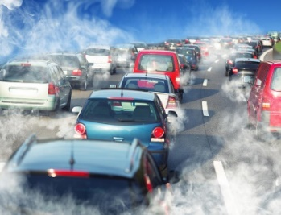
Chapter 2. Drivers of climate change
2. Anthropogenic drivers of climate change
  Technological development and transportation
Transportation is the fastest growing major contributor to global climate change,
accounting for 23% of energy-related carbon dioxide (CO2) emissions.
Transport emissions which primarily involve road, rail, air and marine transportation accounted for over 24% of global CO2 emissions in 2016. They're also expected to grow at a faster rate than that from any other sector, posing a major challenge to efforts to reduce emissions . Climate change is likely to have more impact on the future of surface transportation than any other issue due to the mobility needs of a growing population in a global economy.
For the transportation sector, there are two key sets of strategies to reduce GHG:
(1) Developments in technology including (Vehicle improvements, Low carbon fuels,
Improving operating efficiency of individual vehicles and highway systems, Reducing energy/carbon associated with construction, maintenance, and operation) and
(2) Changing attitudes towards travel that includes (Car Sharing and reduce number of car, walk or cycling short distances that is good for health, taking public bus rather than private car)

Slide 37


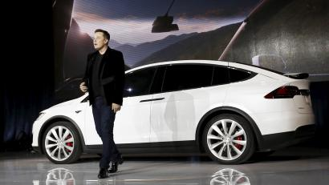

Slide 38
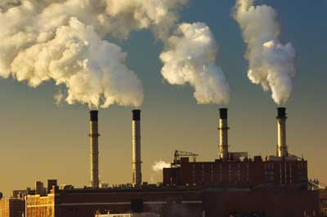
Chapter 2. Drivers of climate change
2. Anthropogenic drivers of climate change
  Increased world industrial activities
With the coming of Industrial revolutions, the use of chemicals and fuel in the factories has increased to a dangerous amount. Along with it, deforestation due to industrial or economic purposes and the excess burning of fossil fuels like natural gas, oil, and coal, has increased the concentration of atmospheric carbon dioxide from 315 ppm (part per million by volume) to about 363 ppm since 1958. Industrial air pollution occurs as the result of the release of pollutants (called emissions) into the atmosphere. The pollutants mix in air and are diluted but may travel long distances on slow, steady winds if an industrial chimney is tall enough to propel them high into the atmosphere. It is a fundamental problem of air pollution science that pollutant concentrations are exceedingly difficult to measure accurately. Industrial development has been associated with emission to air of large quantities of gaseous and particulate emissions from both industrial production and from burning fossil fuels for energy and transportation.
Industry (21% of 2010 global greenhouse gas emissions): Greenhouse gas emissions from industry primarily involve fossil fuels burned on site at facilities for energy. This sector also includes emissions from chemical, metallurgical, and mineral transformation processes not associated with energy consumption and emissions from waste management activities

Slide 39
Chapter 2. Drivers of climate change
2. Anthropogenic drivers of climate change
  Material and energy consumption growth
Energy is a fundamental input to economic activity. Modern energy services light up our homes and schools, fuel economic activity to produce and consume, provide comfort and mobility, pump water and contribute to health and well-being. Harnessing energy sources to replace manual and animal labour was the platform of the Industrial Revolution: a period of unprecedented economic and social development. The 20th century witnessed large increases in the global population, economic output and fossil fuel consumption. Yet these gains have taken a toll on a range of environmental systems where unsustainable practices have dominated. Continuing deterioration of natural resources could stress the ability to meet the needs of a growing population and undermine economic activity. A major transformation is required in the way we produce, deliver and consume energy.
Lifestyle, culture and behaviour significantly influence material and energy consumption in in an area. For developed countries, scenarios indicate that lifestyle and behavioural changes could reduce energy demand by up to 20% in the short term and by up to 50% of present levels by mid-century.

Slide 40
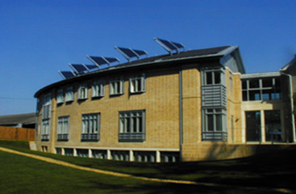
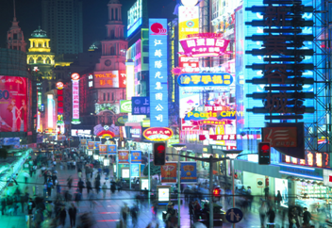
Chapter 2. Drivers of climate change
2. Anthropogenic drivers of climate change
  Material and energy consumption growth
Global demand for energy is increasing rapidly, because of population and economic growth, especially in emerging market economies. While accompanied by greater prosperity, rising demand creates new challenges. Energy security concerns can emerge as more consumers require ever more energy resources. And higher consumption of fossil fuels leads to higher greenhouse gas emissions, particularly carbon dioxide (CO2), which contribute to global warming. At the same time, the number of people without access to electricity remains unacceptably high.
Energy consumption of space heating and cooling; water heating; refrigeration cooling in residential, commercial, and industrial buildings. Energy consumption for pumping water for irrigated agriculture and municipal uses; electricity used for air conditioning; and energy consumption in key sectors of the economy, such as transportation, construction, agriculture, and others.
Improvements in GHG emission efficiency and in the efficiency of material use, recycling and re-use of materials and products, and overall reductions in product demand .
Urban Energy Systems
Low Energy Buildings

Slide 41
Chapter 2. Drivers of climate change
2. Anthropogenic drivers of climate change
  Land use change and deforestation
Forests (vegetable) are often inhale (sequester) carbon dioxide (CO2) from the atmosphere through photosynthesis and they exhale oxygen (O2). As trees and vegetation grow, they store the carbon which makes up about half of their total biomass. Globally, forests store large amounts of carbon sequestered from the atmosphere and retained in living and dead biomass and soil.
Forests store large amounts of carbon in their biomass and perform the very important ecosystem service of helping to regulate the global climate. When forests are converted to other land uses, they release their carbon as carbon dioxide, an important greenhouse gas. Increases in emissions of carbon dioxide and other greenhouse gases have led to global climate change. Intensive Land use change and deforestation has be carried out due to increasing population.
Forests play a critical role in protecting the Earth from climate change and regulating climate patterns, as the trees trunks, branches and roots and even soil absorb and store CO2, providing a natural reservoir for this GHG. However, when forests are destroyed or degraded by activities such as logging and conversion of forests to agricultural land, they release large quantities of CO2 and other GHGs, and become a significant (and, for some developing countries, a primary) source of GHG emissions and contributor to climate change.

Slide 42
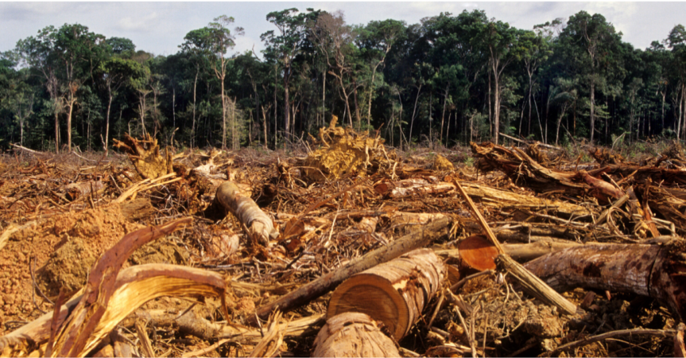
Chapter 2. Drivers of climate change
2. Anthropogenic drivers of climate change
  Land use change and deforestation
Most forests are darker (i.e., lower albedo) than grasses and croplands, which are darker than barren land and desert. As a consequence, deforestation tends to increase the Earth albedo (negative RF) while cultivation of some bright surfaces may have the opposite effect.
Rice paddies are a large source of CH4, an assessment of the agricultural effects of global environmental change must include rice as a crop of primary interest.
Farmers normally flood rice fields throughout the growing season, meaning that methane is produced by microbes underwater as they help to decay any flooded organic matter.
Drivers of Deforestation are Agriculture (commercial), Agriculture (local/subsistence), Infrastructure, Mining, Urban expansion & Forest Degradation) and

Slide 43
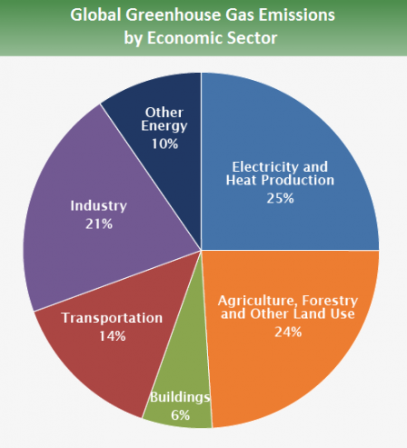
Source: IPCC (2014)

